Slide 1
CSE 8A – Introduction to Programming and Computational Problem Solving I
CS1-LLMs Materials © 2023 by Leo Porter, Dan Zingaro, and Christine Alvarado is licensed under CC BY-NC-SA 4.0
Dictionaries and
Problem Decomposition
How to get help:
Class Website
https://sites.google.com/ucsd.edu/cse8afa23/home
Piazza for brief questions or logistic questions
Tutor Hours for help with homework/setting up computer To get help, use Autograder (directions on piazza)
Office Hours for homework/conceptual help
Slides based, in part, on materials from Dan Zingaro and Christine Alvarado.
Notes:
Welcome!

Slide 2
Announcements
Reading Quiz 7 due next Tuesday at noon
Homework 5 due Monday at 10pm
Take-home Lab 5
Quiz 2 homework retake – due next Tuesday.
Project 1 – Checkpoint due today, full version due next Thursday.
Have fun! Do something interesting or meaningful!

Slide 3
Learning Goals for Today
By the end of today’s lecture, you should be able to:
Read, modify, and write code that includes dictionaries and tuples
Identify problems where dictionaries can be helpful
Use Dictionaries and Problem Decomposition to perform Markov Text Generation

Slide 4
Review: Fill in the code to remove all movies before the year 2000?
dct = {('Ghostbusters', 2016): 5.4, ('Ghostbusters', 1984): 7.8, ('Cars', 2006):7.1}
to_remove = []
for i in dct:
if(i[1] < 2000):
to_remove.append(i)
#Fill in missing line(s)
What should go in the missing block above?
dct.del(to_remove)
del dct[to_remove]
for i in to_remove:
dct.pop(i)
for x, y in dct.items():
dct.pop(x)
for i in dct:
dct.pop(i)
Notes:
for i in to_remove:
dict.pop(i)
Del and pop won’t take lists
Options D and E would delete everything in the lists except they cause an error for deleting from the list while iterating
Talk through the need to do this in two stages

Slide 5
dct = {'a':1, 'b':1, 'c':1}
chars = ['a','c','d']
for char in chars:
if dct.get(char):
dct[char] = dct[char]+1
else:
dct[char] = 1
print(dct)
What is printed?
{'a': 2, 'b': 1, 'c': 2, 'd’: 1}
{'a': 2, 'b': 1, 'c': 2}
{'a’: 1, 'b': 1, 'c’: 1, 'd': 1}
None of the above
Notes:
{'a': 2, 'b': 1, 'c': 2, 'd': 1}
Could replace if/else with dct[char] = dct.get(char,0)+1

Slide 6
Word Cloud (group activity)
Let’s create a program that reads in a file called “words.txt” and creates a dictionary that stores words and the number of times that word appeared.
Example: Suppose words.txt contained the two lines below
bat vampire zombie ghost
bat zombie bat
The resulting dictionary should be:
{'bat': 3, 'vampire': 1, 'zombie': 2, 'ghost': 1}
Notes:
Talk about the steps in this process before kicking it off
STEPS:
- open the file
- read word by word
- if it’s not in the dictionary, increment count
-if it’s in the dictionary, increment count
Maybe sort at the end…
TODO – often stores the order in which you insert items
To Sort: sorted_data = sorted(data.items(), key=operator.itemgetter(1),reverse=True)
import string
data = {}
f = open("words.txt","r")
line = f.readline()
while line:
words = line.split()
for word in words:
x = data.get(word)
if x:
data[word] = data[word] + 1
else:
data[word] = 1
line = f.readline()
print(data)

Slide 7
Markov Text Generation
Let’s create text that appears/sounds like it came from a different source (this is a precursor to LLMs)
Plan:
- Discuss the idea
- Do some small sample questions
- Code up a larger example together

Slide 8
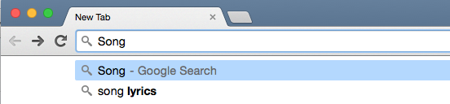
Predicting the future

Slide 9
Predicting the future

Slide 10
Predicting the future: Markov processes
Current State

Slide 11
Predicting the future: Markov processes
Current State

Slide 12
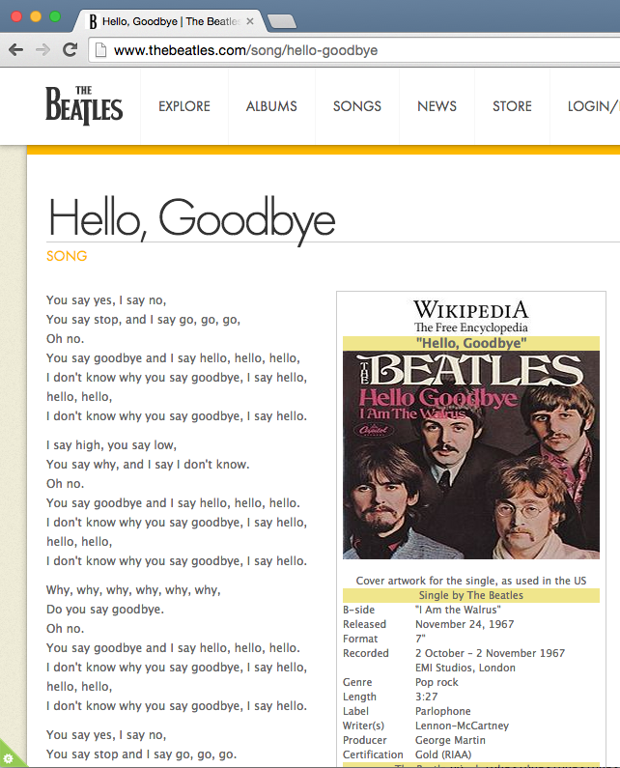

Slide 13
You say hello. I don't know why you say hello, hello. I say goodbye. Oh no. You say no, You

Slide 14
You
say
Notes:
"You" always followed by "say"

Slide 15
You
say
You say hello. I don't know why you say hello, hello. I say goodbye. Oh no. You say no, You
Notes:
"You" always followed by "say"

Slide 16
Suppose "hello." is followed by:
"I", "I", "Why", "I", "You", and "You"
What should be the Markov Model for the word "hello."?
Notes:
"You" always followed by "say"

Slide 17
Suppose "hello." is followed by:
"I", "I", "Why", "I", "You", and "You"
What should be the Markov Model for the word "hello."?
I
3/6
hello.
1/6
Why,
2/6
You
Notes:
"You" always followed by "say"

Slide 18

Stage 1: Train
Build model based on data
Notes:
"You" always followed by "say"

Slide 19
Stage 1: Train
Build model based on data
"You say yes, I say no, You say …"
Notes:
"You" always followed by "say"

Slide 20
Stage 1: Train
Build model based on data
"You say yes, I say no, You say …"
For each new word:
need to keep track of word + next words
Notes:
"You" always followed by "say"

Slide 21
Stage 1: Train
"You" | "say" | "yes," | "I" | "say" | "no," | "You" | "say"
For each new word:
need to keep track of word + next words
Notes:
"You" always followed by "say"

Slide 22
For each new word:
need to keep track of word + next words
Stage 1: Train
"You" | "say" | "yes," | "I" | "say" | "no," | "You" | "say"
word
"You"
nextWords
"say"
Notes:
"You" always followed by "say"

Slide 23
For each new word:
need to keep track of word + next words
Stage 1: Train
"You" | "say" | "yes," | "I" | "say" | "no," | "You" | "say"
word
"You"
word
"say"
nextWords
"say"
nextWords
"yes,"
Notes:
Keep going through the next "say" to show duplicates

Slide 24
Stage 1: Train
"I don't know why you say goodbye, I say hello. I say high, you say low, …
I
3/6
hello.
1/6
Why,
2/6
You
Notes:
Draw the model of “hello.” pointing to “I”

Slide 25
Stage 1: Train
… I say hello, hello, hello. I don't know why you say goodbye …
word
"hello."
nextWords
"I" , "I"
I
3/6
hello.
1/6
Why,
2/6
You
Notes:
"You" always followed by "say"

Slide 26
Stage 1: Train
… I say hello. Why, why, why, why, why, why, …
word
"hello."
I
nextWords
"I" , "I" , "Why,"
3/6
hello.
1/6
Why,
2/6
You
Notes:
"You" always followed by "say"

Slide 27
Stage 1: Train
… hello, hello, hello. I don't know …
word
"hello."
I
nextWords
"I" , "I" , "Why," , "I"
3/6
hello.
1/6
Why,
2/6
You
Notes:
"You" always followed by "say"

Slide 28
Stage 1: Train
... I say hello. You say yes, I say no, …
word
"hello."
I
nextWords
"I" , "I" , "Why," , "I" , "You"
3/6
hello.
1/6
Why,
2/6
You
Notes:
"You" always followed by "say"

Slide 29
Stage 1: Train
etc.
word
"hello."
I
nextWords
"I" , "I" , "Why," , "I" , "You" , "You"
3/6
hello.
1/6
Why,
2/6
You
Notes:
"You" always followed by "say"

Slide 30
To create this Markov Model, what data structure should we use?
List
2D List
Dictionary
Tuple
None of the above
Notes:
C – Dictionary!

Slide 31
Summary
Dictionaries store immutable keys to corresponding values (where values can be any type of object)
Fast when searching for values
Useful in many contexts!
Markov Text Prediction is a way of generating human-like language
More next class!

